Slide 1
Integrated Disclosures Zack Boonjue zack@ppdocs.com
Notes:
I’m the general manager at P&P Arlington. I have been working with docs for nearly 20 years. My specialty is automating them.
In this presentation, I will introduce you to the forms required by the respa – tila integration effective august 2015. We will look at the LE loan estimate, CD closing disclosure and finally the identified service provider.

Slide 2
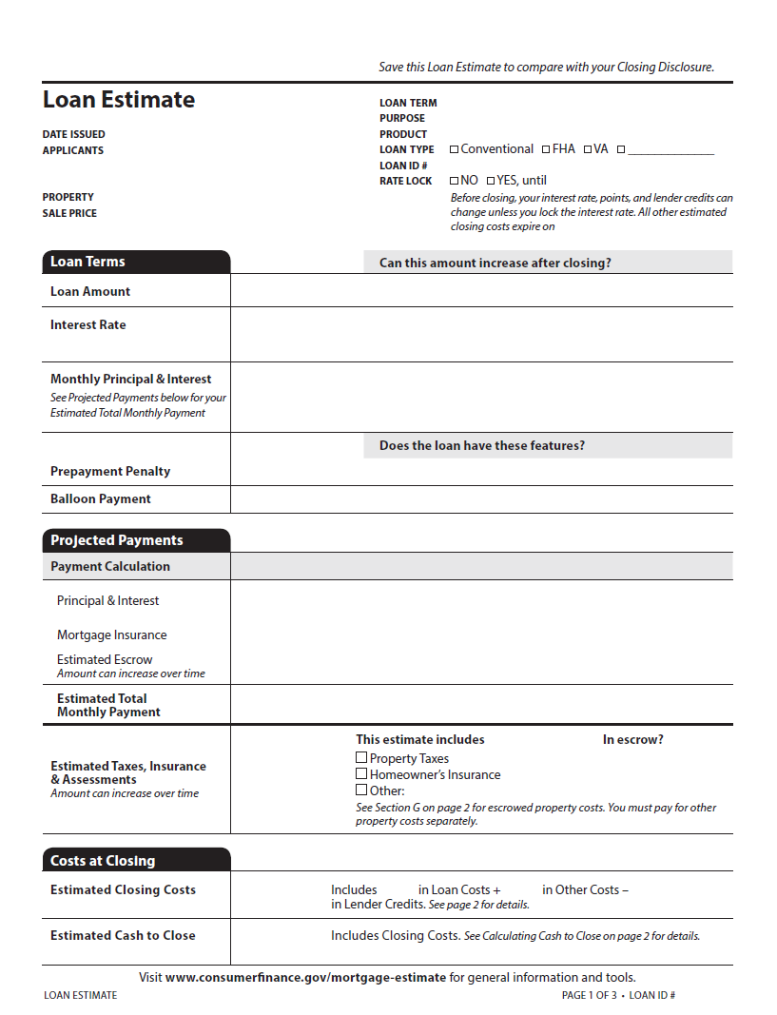
Page 1: General
General information related to applicants, property, loan, and rate lock status; loan terms; projected payments during the term of the loan; costs at closing, including the total estimated closing costs and the estimated cash to close.

Slide 3
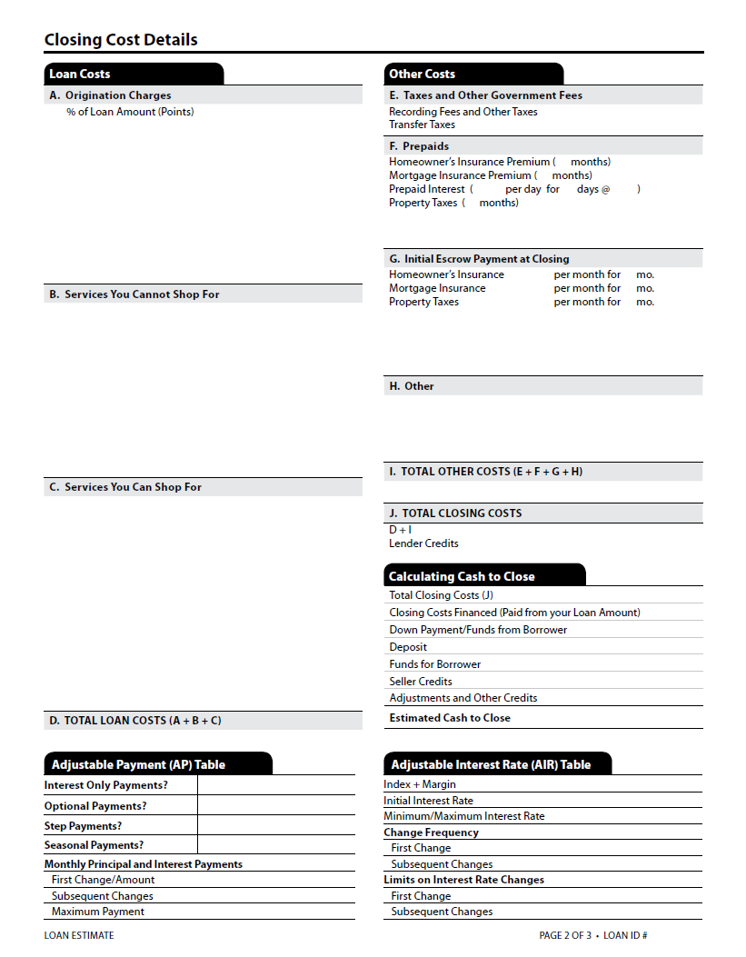
Page 2: Costs
Loan costs; other costs; calculating cash to close; adjustable interest rate table (when applicable); adjustable payment table (when applicable).

Slide 4
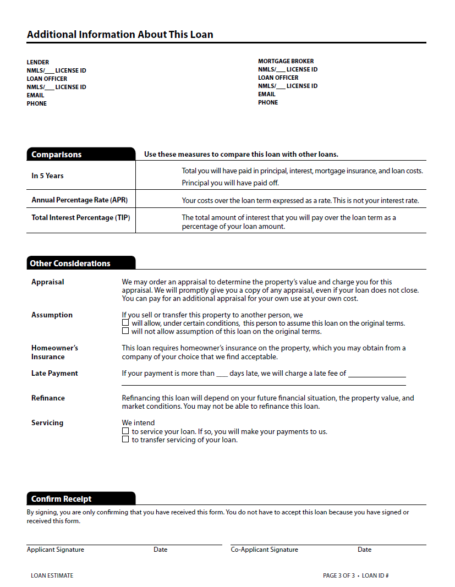
Page 3: Other
Contact information for creditor and loan officer; comparisons; other considerations; and confirm receipt (optional)

Slide 5
First Impression
Dynamic with MANY variations. Cannot do by hand.
Strict rules for term, purpose, and product description
Alphabetized list of fees with limited number of lines
Difficult to complete Projected Payments
No longer possible to test APR with OCC APR tool
Inconsistent rounding

Slide 6
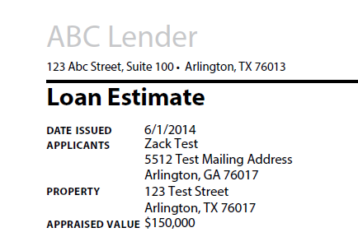
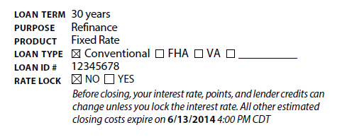
Let’s take a closer look
30 years
2 yr, 6 mo.
18 mo.
1 year
6 mo.
Purchase
Refinance
Construction
Home Equity
Fixed Rate
10 yr. Interest Only, Fixed Rate
2.5 Year Interest Only, 5/1 Adjustable Rate
Year 15 Balloon Payment, 0/2.5 Adjustable Rate
18 mo./2 Adjustable Rate
Notes:
Samples from different loans.

Slide 7
Describing Time Period
Describe the Loan Term as “years” when the Loan Term is in whole years.
For example “1 year” or “30 years.”
For a Loan Term that is more than 24 months but is not whole years, describe using years and months with the abbreviations “yr.” and “mo.,” respectively.
For a Loan Term that is less than 24 months and not whole years, use months only
with the abbreviation “mo.”
Examples:
185 months = 15 yr., 5mo. 24 months = 2 Yr.
6 months = 6 mo. 18 months = 18 mo.

Slide 8
Describing Product
[duration] Negative Amortization
[duration] Interest Only
[duration] Step Payment
[duration] Balloon Payment
[duration]
Seasonal Payment
[1st change]/[changes] Adjustable Rate
[1st change]/[changes] Step Rate
Fixed Rate
+
Include 2 pieces of information, one from each column. When the durations are not in whole years:
for time periods of 24 months or more, disclose the applicable fraction of a year by use of decimals rounded to two places. Ex: 31 months = 2.58
For time periods of 24 months or less, disclose the number of months with the abbreviation “mo.”

Slide 9
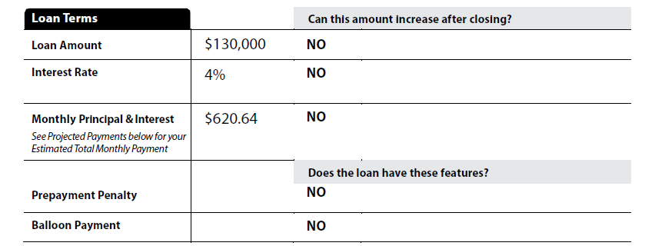
LE – Loan Terms

Slide 10
LE – Projected Payments Table
Triggers
Change in Principal & Interest
Balloon Payment
MI Termination
How to comply? You have to watch out for…
Easy for consumers to understand.
Dificult for creditors to complete
=
Rounding to nearest dollar
Events occurring mid-year
Ignore odd days interest
Consumer buy-down vs third party buy-down
Ranges of Payments
Max MI within range
Best case scenario
Running out of columns
Only interest statement
MI termination vs no MI
Worst case scenario
Notes:
You have to worry about rounding, number of columns, MI, payment ranges, best case, worst case, interest only and so on…

Slide 11
LE – Projected Payments
30 Year Fixed Rate - No MI

Slide 12
LE – Projected Payments
30 Year Fixed Rate w/ MI

Slide 13
LE – Projected Payments
30 Year 5/1 ARM – No MI

Slide 14
LE – Projected Payments
15 Year Balloon ARM w/ MI

Slide 15
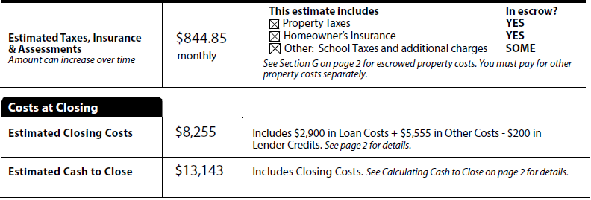
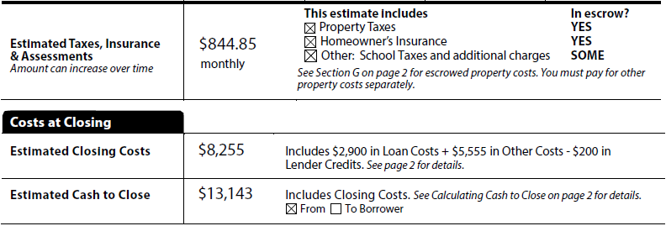
LE – Bottom Pg1
Notes:
They gave us 1 box for other
There is an alternative version

Slide 16
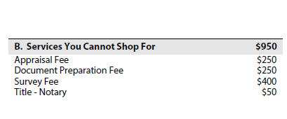
LE – Page 2
Closing Cost Details – Loan Costs
13 items max
Do not disclose compensation to a LO by creditor
Ex: Origination Fee and other items paid to creditor
13 items max
Ex: Appraisal, Credit Report, Doc-Prep to PPDocs, VA Funding Fee, Lender’s Title Policy
14 items max OR Addendum
Must provide contact info for fee you quoted
Ex: Pest Inspection, Survey

Slide 17
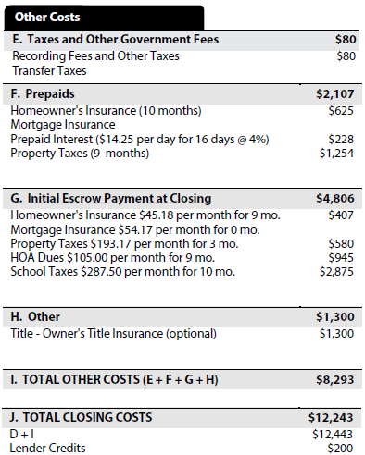
LE – Page 2
Closing Cost Details – Other Costs
Both lines hard-code. No additional lines
Per-diem with pennies
4 lines hard-coded. Max 3 additional lines
Show pennies
3 lines hard-coded. Max 5 additional lines
Omit aggregate adjustment. See comment 1026.37(g)(3)-2.
Other other. Max 5
All cost less lender credits (Blanket credit)
Notes:
Omit Agg
Other Other

Slide 18
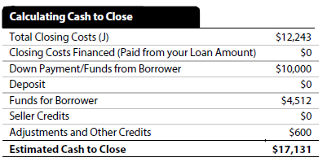
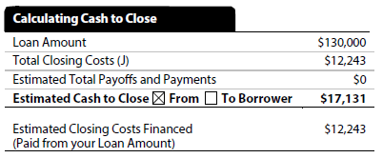
LE – Page 2
Transactions with Seller
Alternate Version

Slide 19
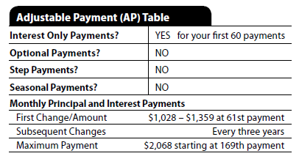
LE – Page 2
Adjustable Payment Table (AP)
Appear when
Interest Only
Optional Payments
Step Payment
Seasonal Payments
Does not appear on ARM
Must be referenced on page 1

Slide 20
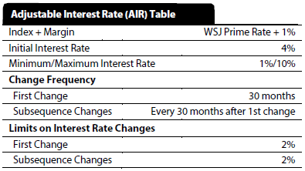
LE – Page 2
Adjustable Interest Rate Table (AIR)
Index description can be abbreviated, but the consumer must be able to reasonably identify it.

Slide 21
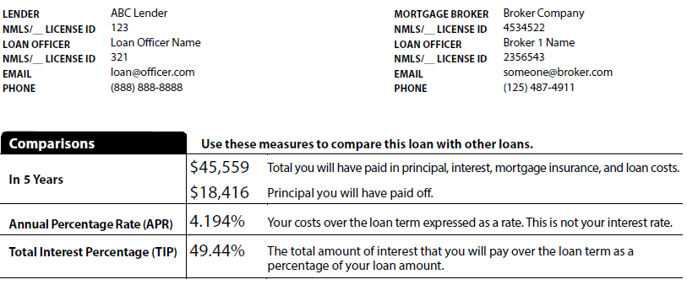
LE – Page 3
Additional Information About This Loan

Slide 22
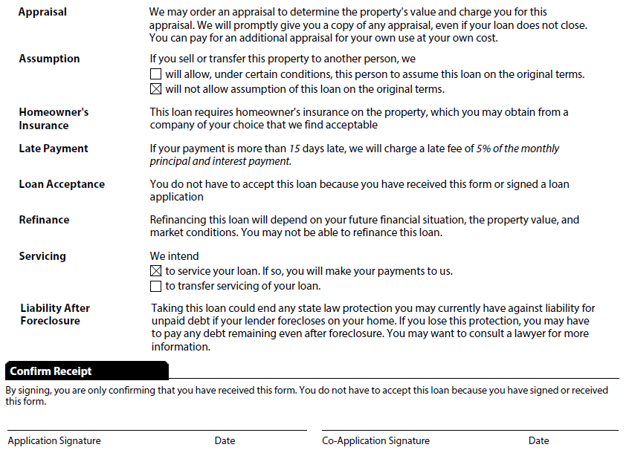
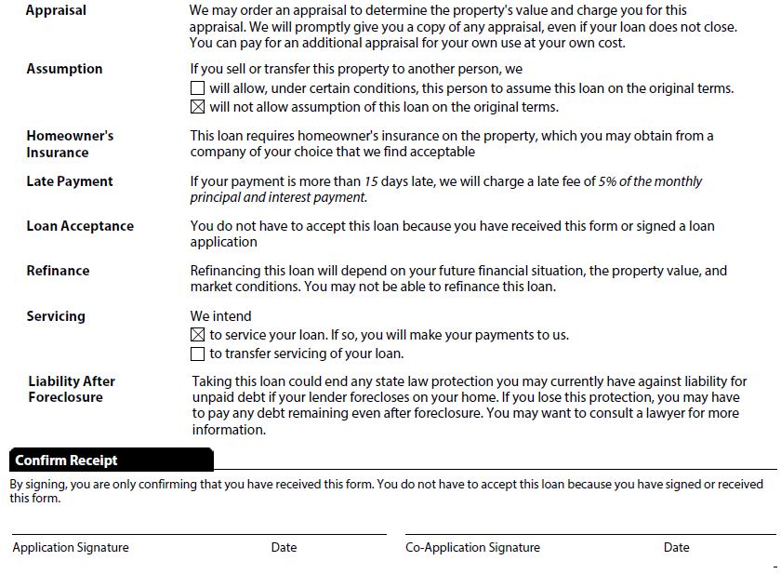
LE – Page 3
Other Considerations

Slide 23
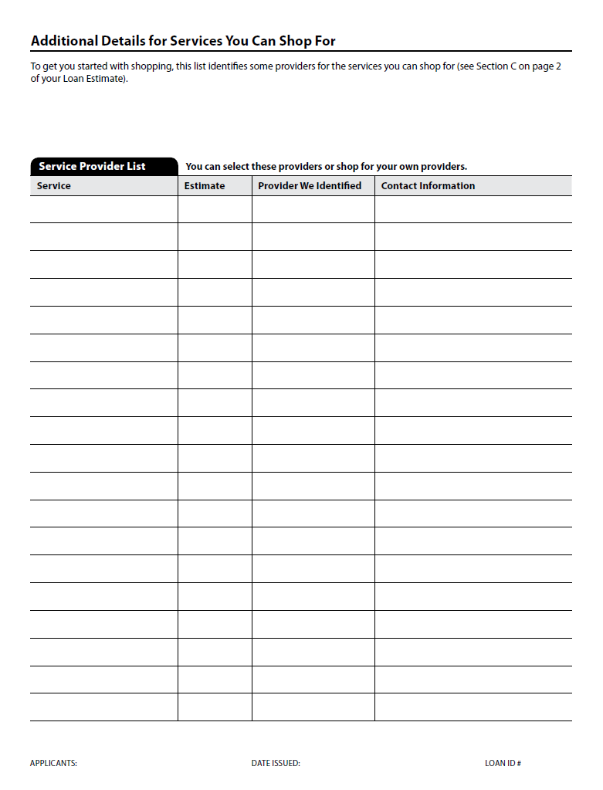
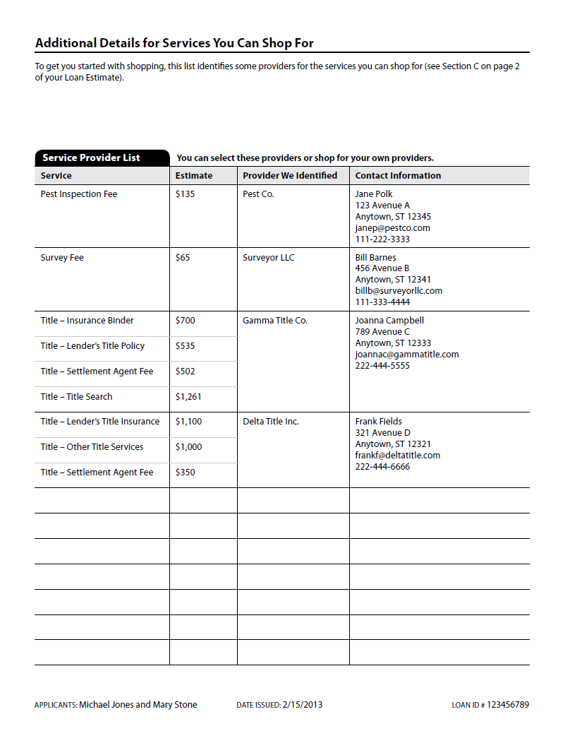
Written List of Service Providers

Slide 24
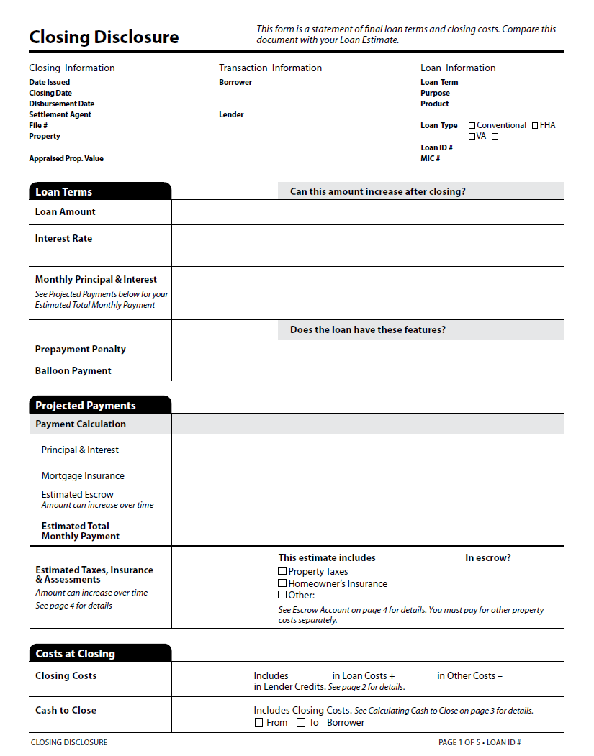
Page 1: General
Information, Loan Terms, Projected Payments, Costs at Closing

Slide 25
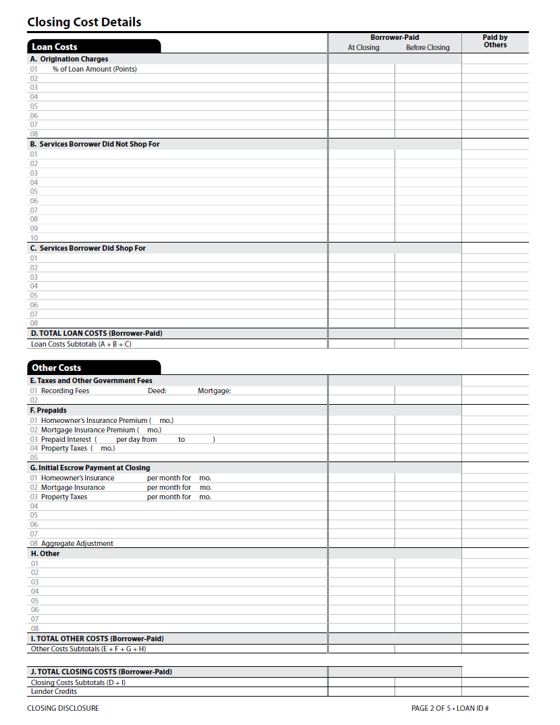
Page 2: Costs
Loan Costs, Other Costs

Slide 26
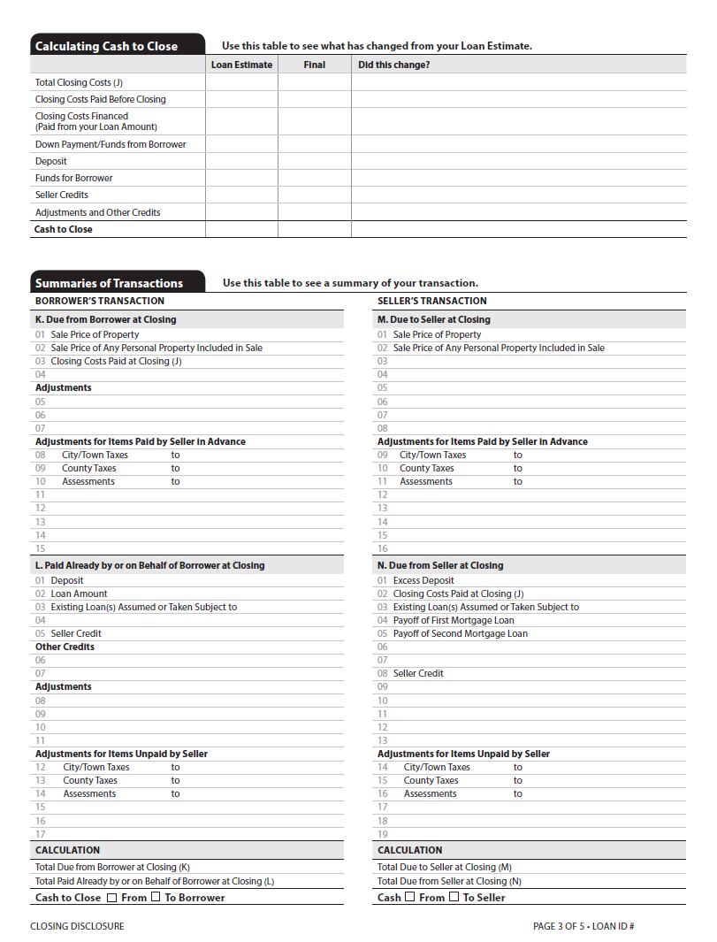
Page 3: Cash to Close and Summaries
Calculating Cash to Close, Summaries of Transactions

Slide 27
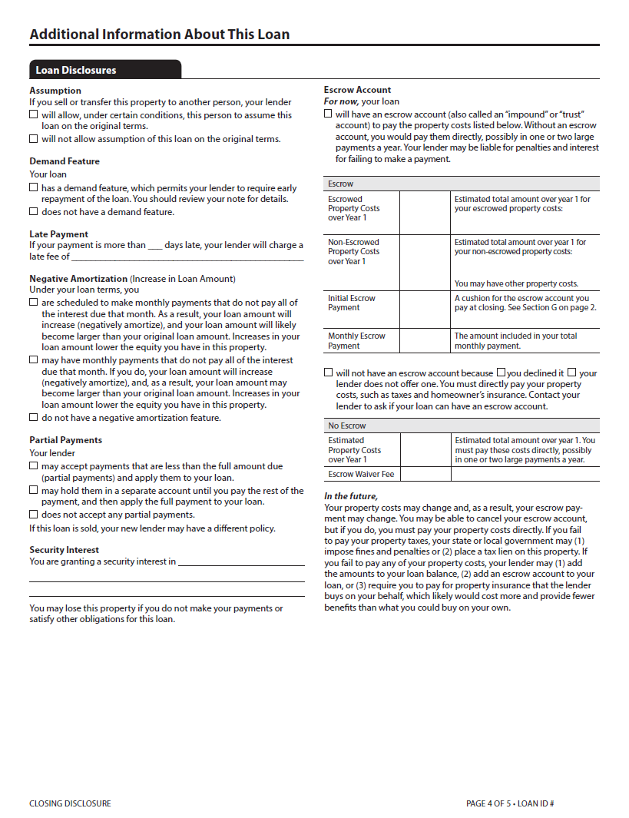
Page 4: Additional Loan Information
Loan Disclosures, Escrow Account, AP and AIR Tables (when applicable)

Slide 28
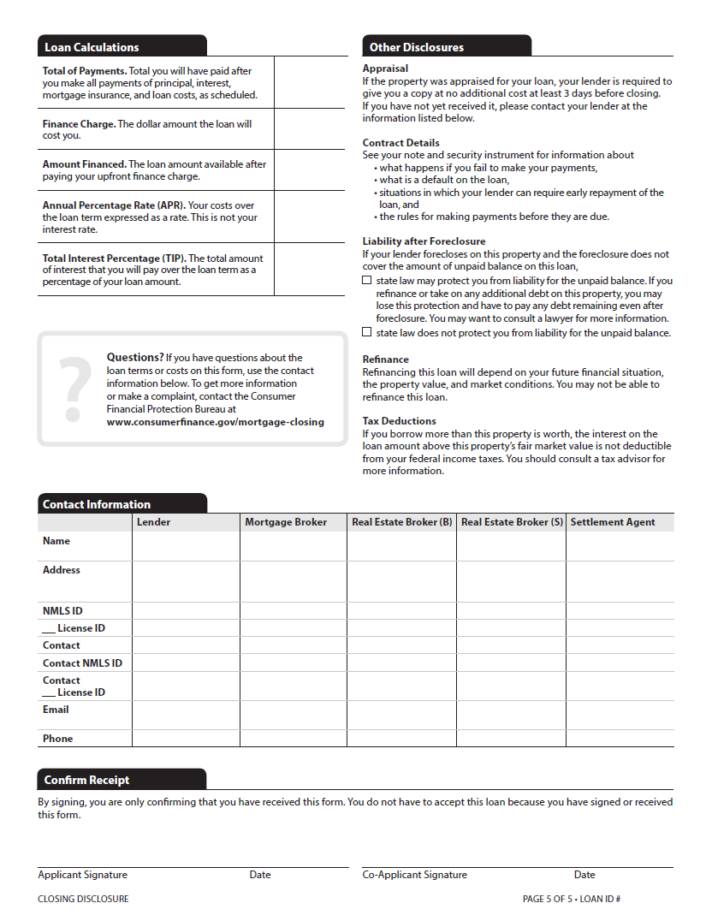
Page 5: Other Information
Loan Calculations, Other Disclosures, Contact Information, Confirm Receipt.

Slide 29
Closing Disclosure – First Impression
1st page nearly identical to LE
Dedicated columns for borrower and seller POCs
Missing tolerance/variance.
Some new disclosures

Slide 30
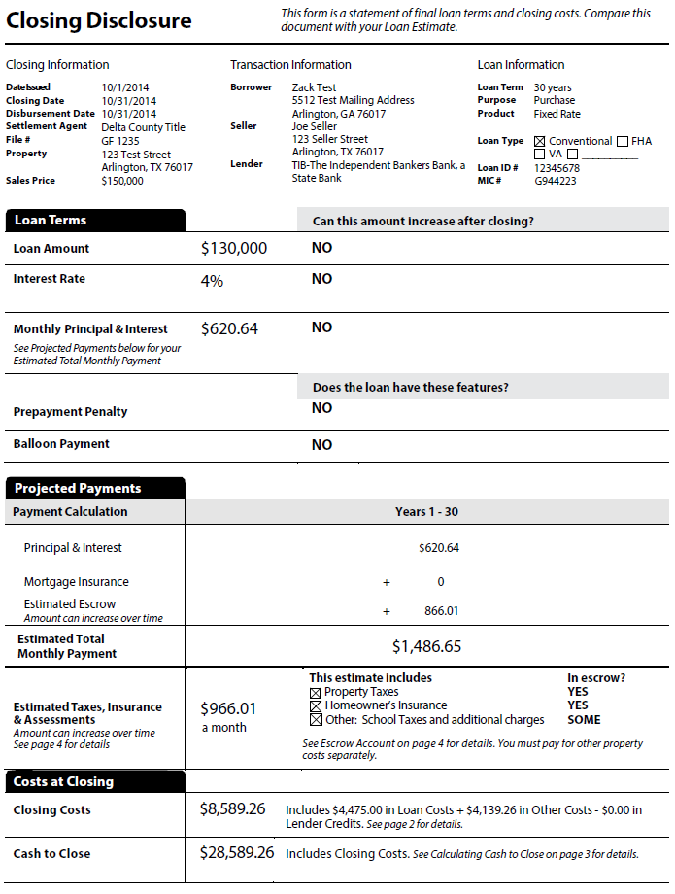
Let’s take a closer look

Slide 31
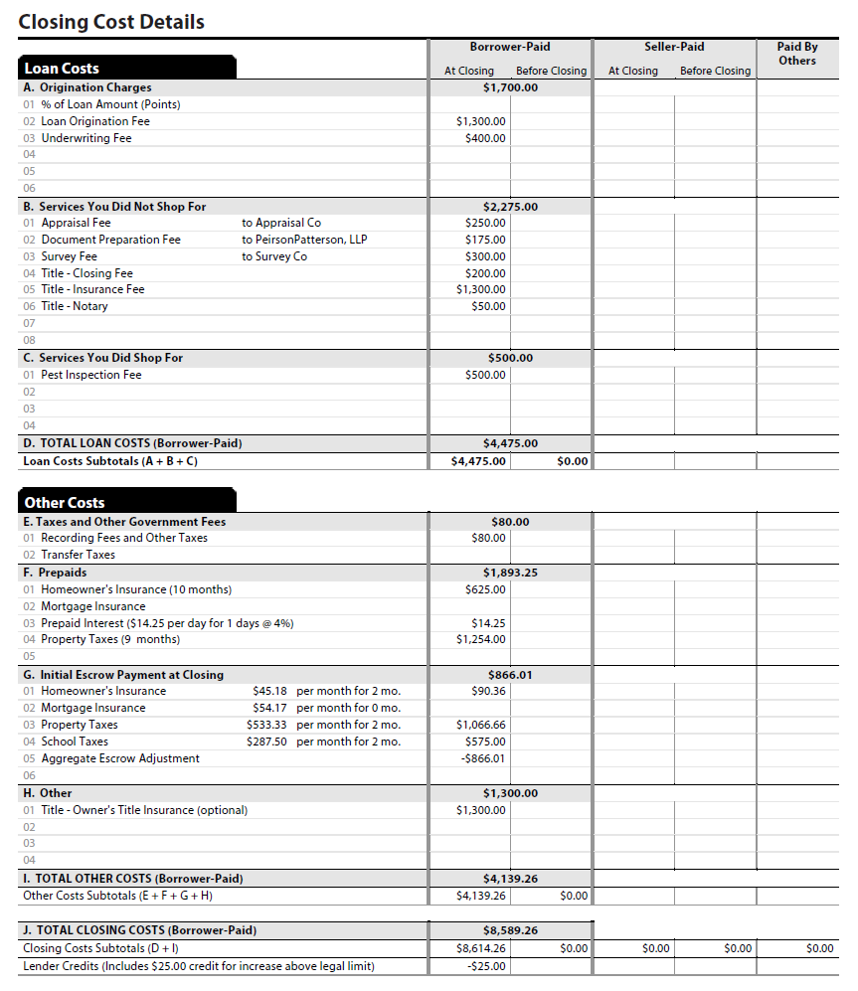
CD Page 2

Slide 32
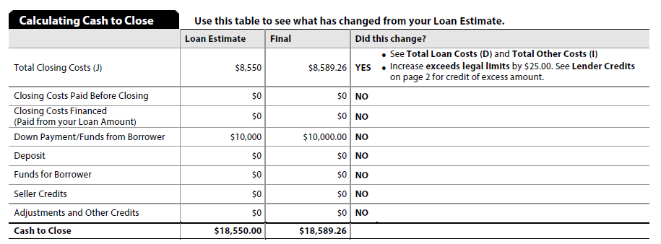
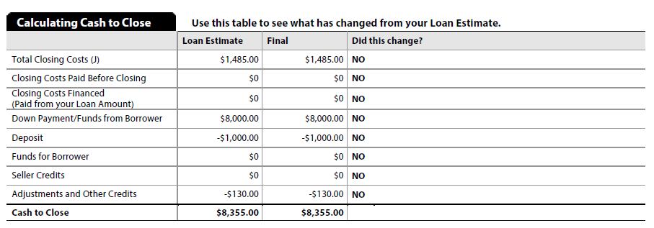
CD Page 3

Slide 33
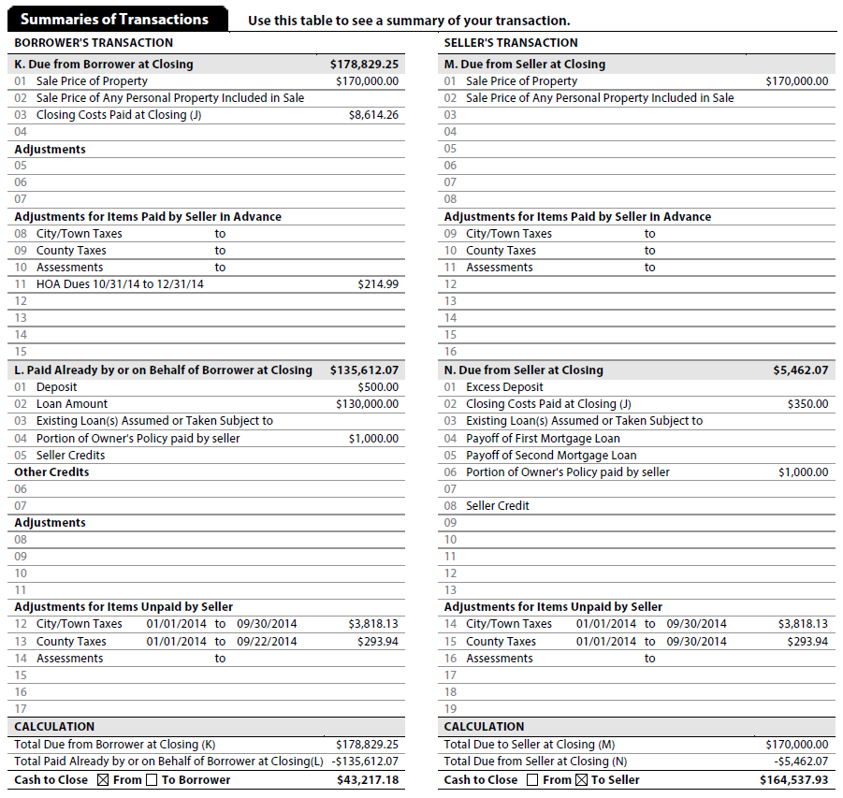
CD Page 3 Cont.

Slide 34
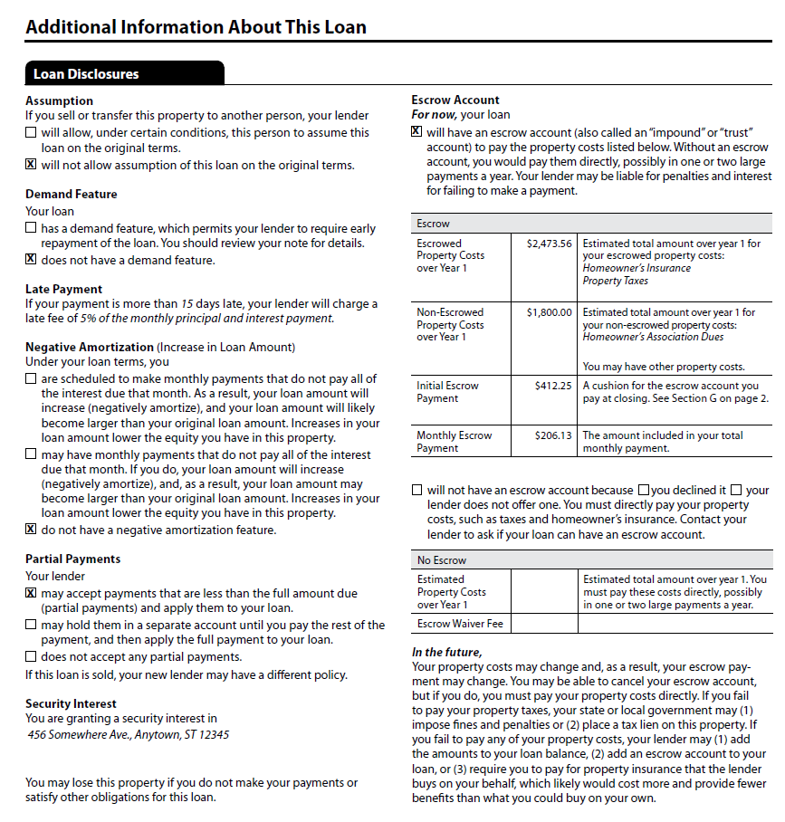
CD Page 4

Slide 35
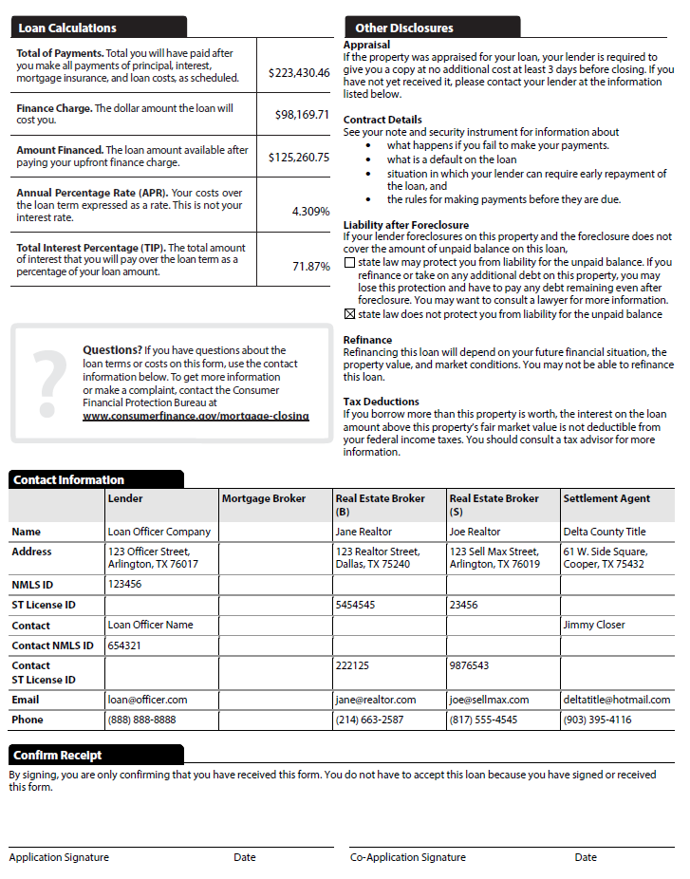
CD Page 5

Slide 36
The Challenge
Creditor responsible for the content of the Closing Disclosures (CD)
CD is governed by Regulation Z and has TILA liability
Consumer(s) must receive CD 3 business days before closing
Creditor must work with settlement agent to get the information they don’t normally have access to.
Solution?
Collaboration

Slide 37
Current Work Flow
Lender
Settlement Agent
Order closing docs
Send Closing Instructions
Send Preliminary HUD-1
Request changes
Send updated HUD-1
Send approval
Notes:
It isn’t yet clear how we are going to get the data from the title companies. With only 8 months left, we are not going to wait for a standard to emerge. We are preparing to accept data through multiple channels. We will accept a direct upload using MISMO 3.3, we will web site to allow settlement agents to input and upload data directly to the file. And worst case scenario, we will allow settlement agents to scan and upload a fee work sheet.

Slide 38
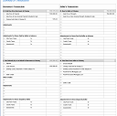
Future Work Flow
Lender
Settlement Agent
collaboration
collaboration
Order closing docs
Send final Closing Disclosure

Slide 39
Features
Website can be branded with lender-client’s name and logo
Invite settlement agent to a mutual workspace
Both parties looking at the same screen
No initial setup required by the invitee
Intuitive workspace. The screen looks like the CD highlighting data changes
Settlement agent can upload data from their system
Lender notified when settlement agent submits the form
Lender can accept or reject changes
Settlement agent notified when Lender accepts or rejects changes
The workspace remains open until Lender closes it
Lender can submit data to PPDocs to generate CD
Lender can export data back to their LOS
Log showing all changes for both parties to see

Slide 40
Lender
Settlement Agent
Knowledge of loan?
Start new loan on PPDocs
Invite
Suggest Changes
Accepts / Reject changes
Notify
Create Closing Disclosure
Notes:
It isn’t yet clear how we are going to get the data from the title companies. With only 7 months left, we are not going to wait for a standard to emerge. We are preparing to accept data through multiple channels. We will accept a direct upload using MISMO 3.3, we will web site to allow settlement agents to input and upload data directly to the file.

Slide 41
How it works
Lender invites settlement agent to collaborate by sending an email
Notes:
It isn’t yet clear how we are going to get the data from the title companies. With only 7 months left, we are not going to wait for a standard to emerge. We are preparing to accept data through multiple channels. We will accept a direct upload using MISMO 3.3, we will web site to allow settlement agents to input and upload data directly to the file.

Slide 42
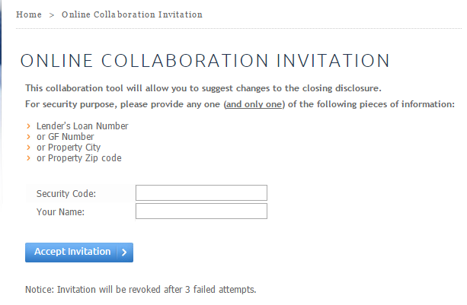
How it works
Settlement agent follows link in email to a website.
Settlement agent required to authenticate by entering something about the loan or a password. Lender’s choice.
Notes:
It isn’t yet clear how we are going to get the data from the title companies. With only 7 months left, we are not going to wait for a standard to emerge. We are preparing to accept data through multiple channels. We will accept a direct upload using MISMO 3.3, we will web site to allow settlement agents to input and upload data directly to the file.

Slide 43
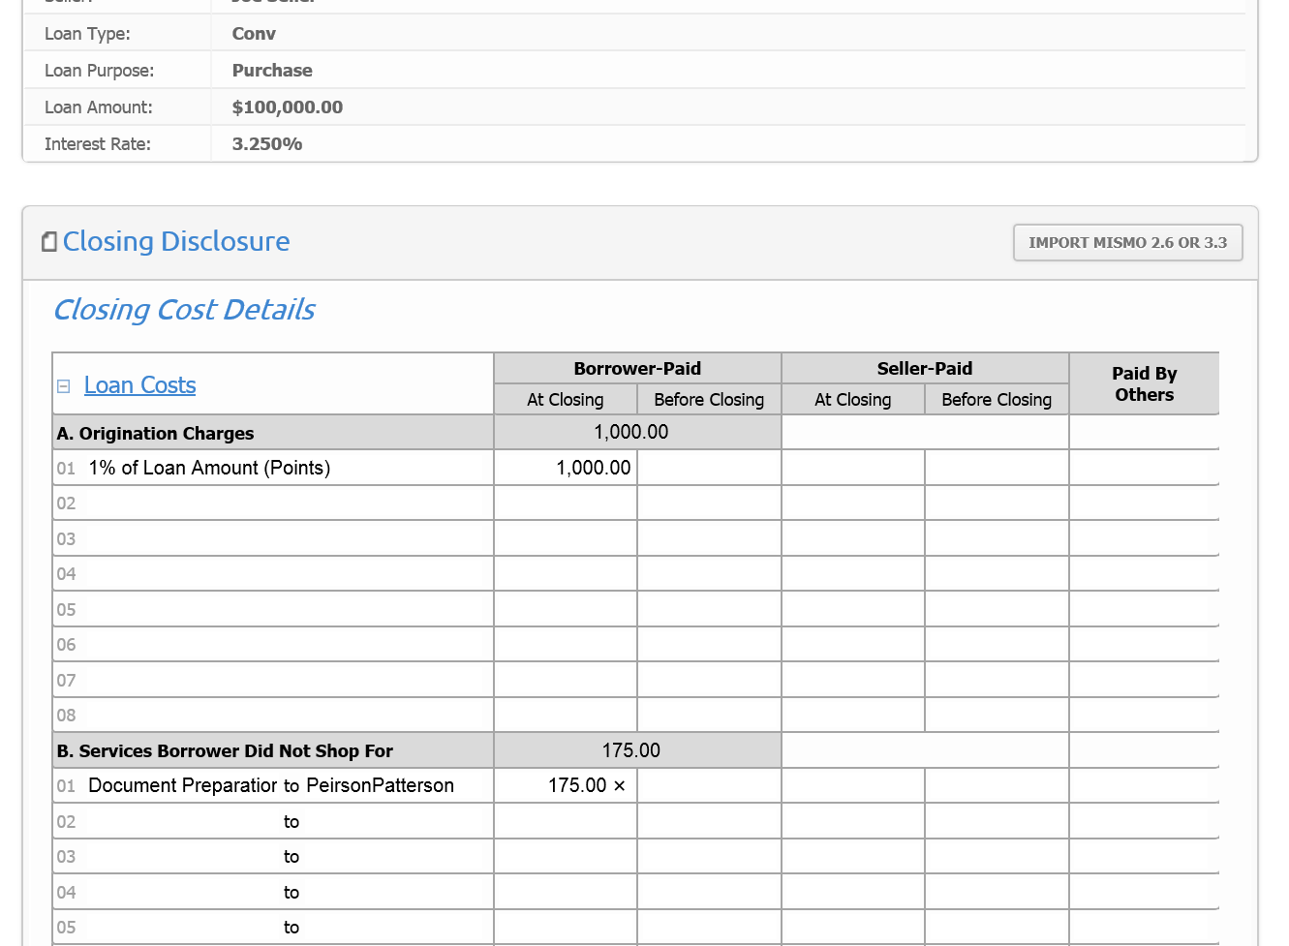
How it works
The screen looks just like the Closing Disclosure
Notes:
It isn’t yet clear how we are going to get the data from the title companies. With only 7 months left, we are not going to wait for a standard to emerge. We are preparing to accept data through multiple channels. We will accept a direct upload using MISMO 3.3, we will web site to allow settlement agents to input and upload data directly to the file.

Slide 44
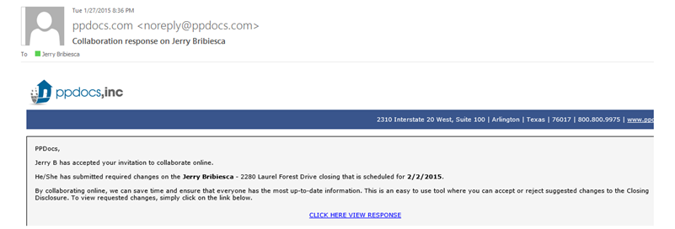
How it works
Notification to Lender when Settlement agent submits the form.
Notes:
It isn’t yet clear how we are going to get the data from the title companies. With only 7 months left, we are not going to wait for a standard to emerge. We are preparing to accept data through multiple channels. We will accept a direct upload using MISMO 3.3, we will web site to allow settlement agents to input and upload data directly to the file.

Slide 45
How it works
New link appears for Lender to review suggested changes
Notes:
It isn’t yet clear how we are going to get the data from the title companies. With only 7 months left, we are not going to wait for a standard to emerge. We are preparing to accept data through multiple channels. We will accept a direct upload using MISMO 3.3, we will web site to allow settlement agents to input and upload data directly to the file.

Slide 46
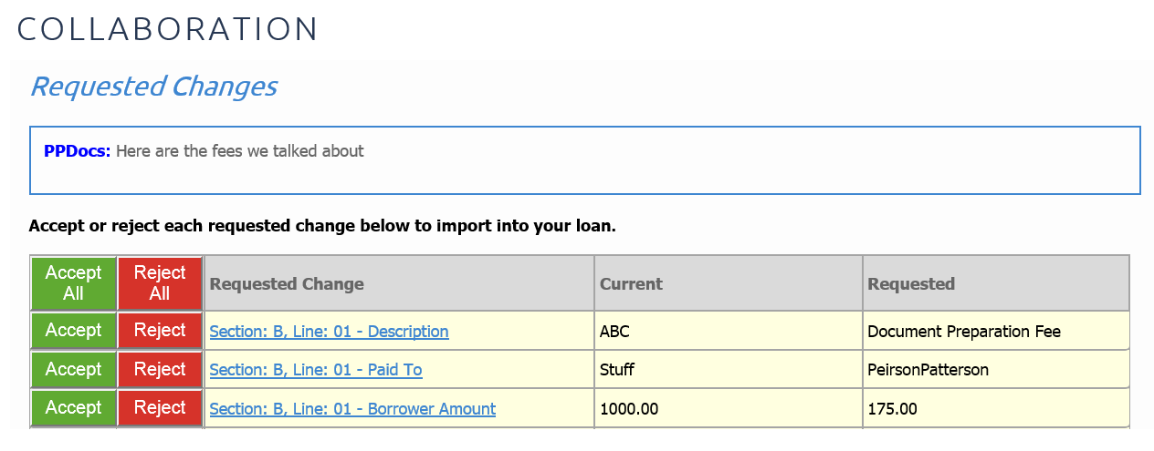
How it works
Lender can accept or reject changes and click link to see how it affects the Closing Disclosure
Notes:
It isn’t yet clear how we are going to get the data from the title companies. With only 7 months left, we are not going to wait for a standard to emerge. We are preparing to accept data through multiple channels. We will accept a direct upload using MISMO 3.3, we will web site to allow settlement agents to input and upload data directly to the file.

Slide 47
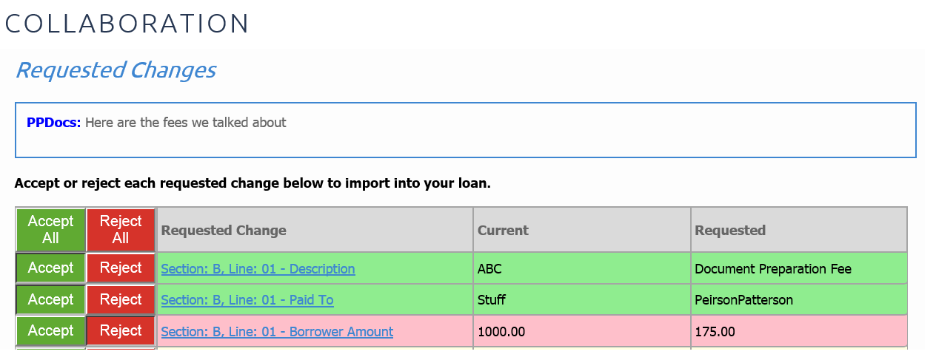
How it works
Color coded decisions for easy navigation
Notes:
It isn’t yet clear how we are going to get the data from the title companies. With only 7 months left, we are not going to wait for a standard to emerge. We are preparing to accept data through multiple channels. We will accept a direct upload using MISMO 3.3, we will web site to allow settlement agents to input and upload data directly to the file.

Slide 48
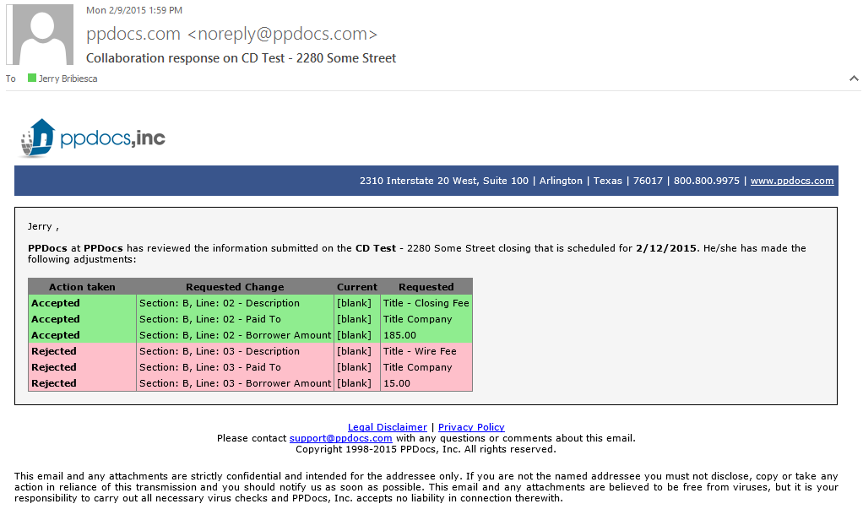
How it works
Settlement Agent notified showing the decisions made
Notes:
It isn’t yet clear how we are going to get the data from the title companies. With only 7 months left, we are not going to wait for a standard to emerge. We are preparing to accept data through multiple channels. We will accept a direct upload using MISMO 3.3, we will web site to allow settlement agents to input and upload data directly to the file.

Slide 49
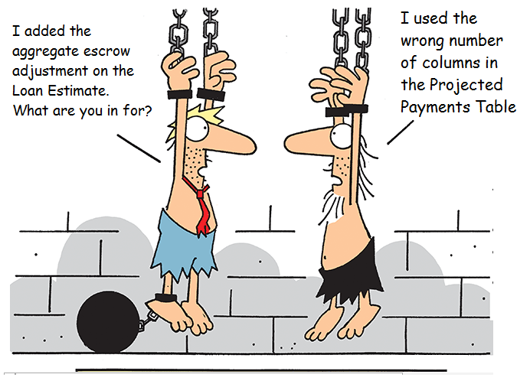
Final Thoughts
Notes:
The key to success is testing, training, and collaboration. I want to mention that the screen shots used in this presentation were created on our system. We have started a beta testing program in November. The program will continue through most of next year. If you are interested in testing with us, please send us an email at support@ppdocs.com. If you do not use us for docs, first I want to urge you to reconsider. Second, you should put pressure on your docs vendor find out where they are at. Ask to test. If you don’t get a response you are looking for, contact us.

